Slide 1
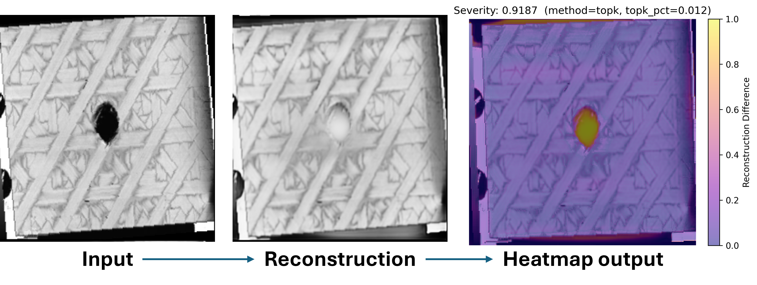
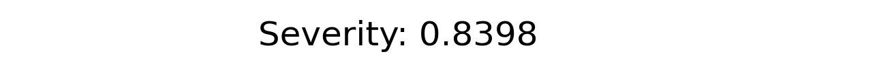
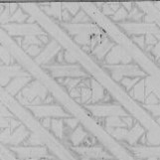
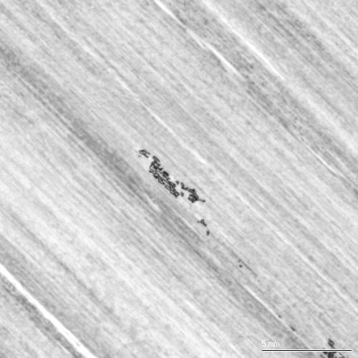
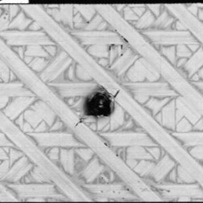
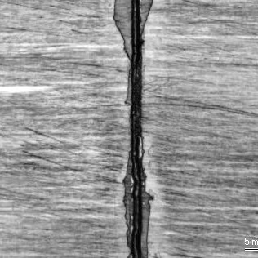

Slide 2
Severity Magnitude
Defect Localization
Defect Classification

Slide 3
| Autonomous Damage Recognition in Ultrasonic Non-Destructive Evaluation Using a Semi-Supervised GAN |
| JonPaul Hooks | Graduate Student
| CSCE 768 – Pattern Recognition and Classification | Final Project
Advisors - Dr. Jianjun Hu | Dr. Sourav Banerjee

Slide 4
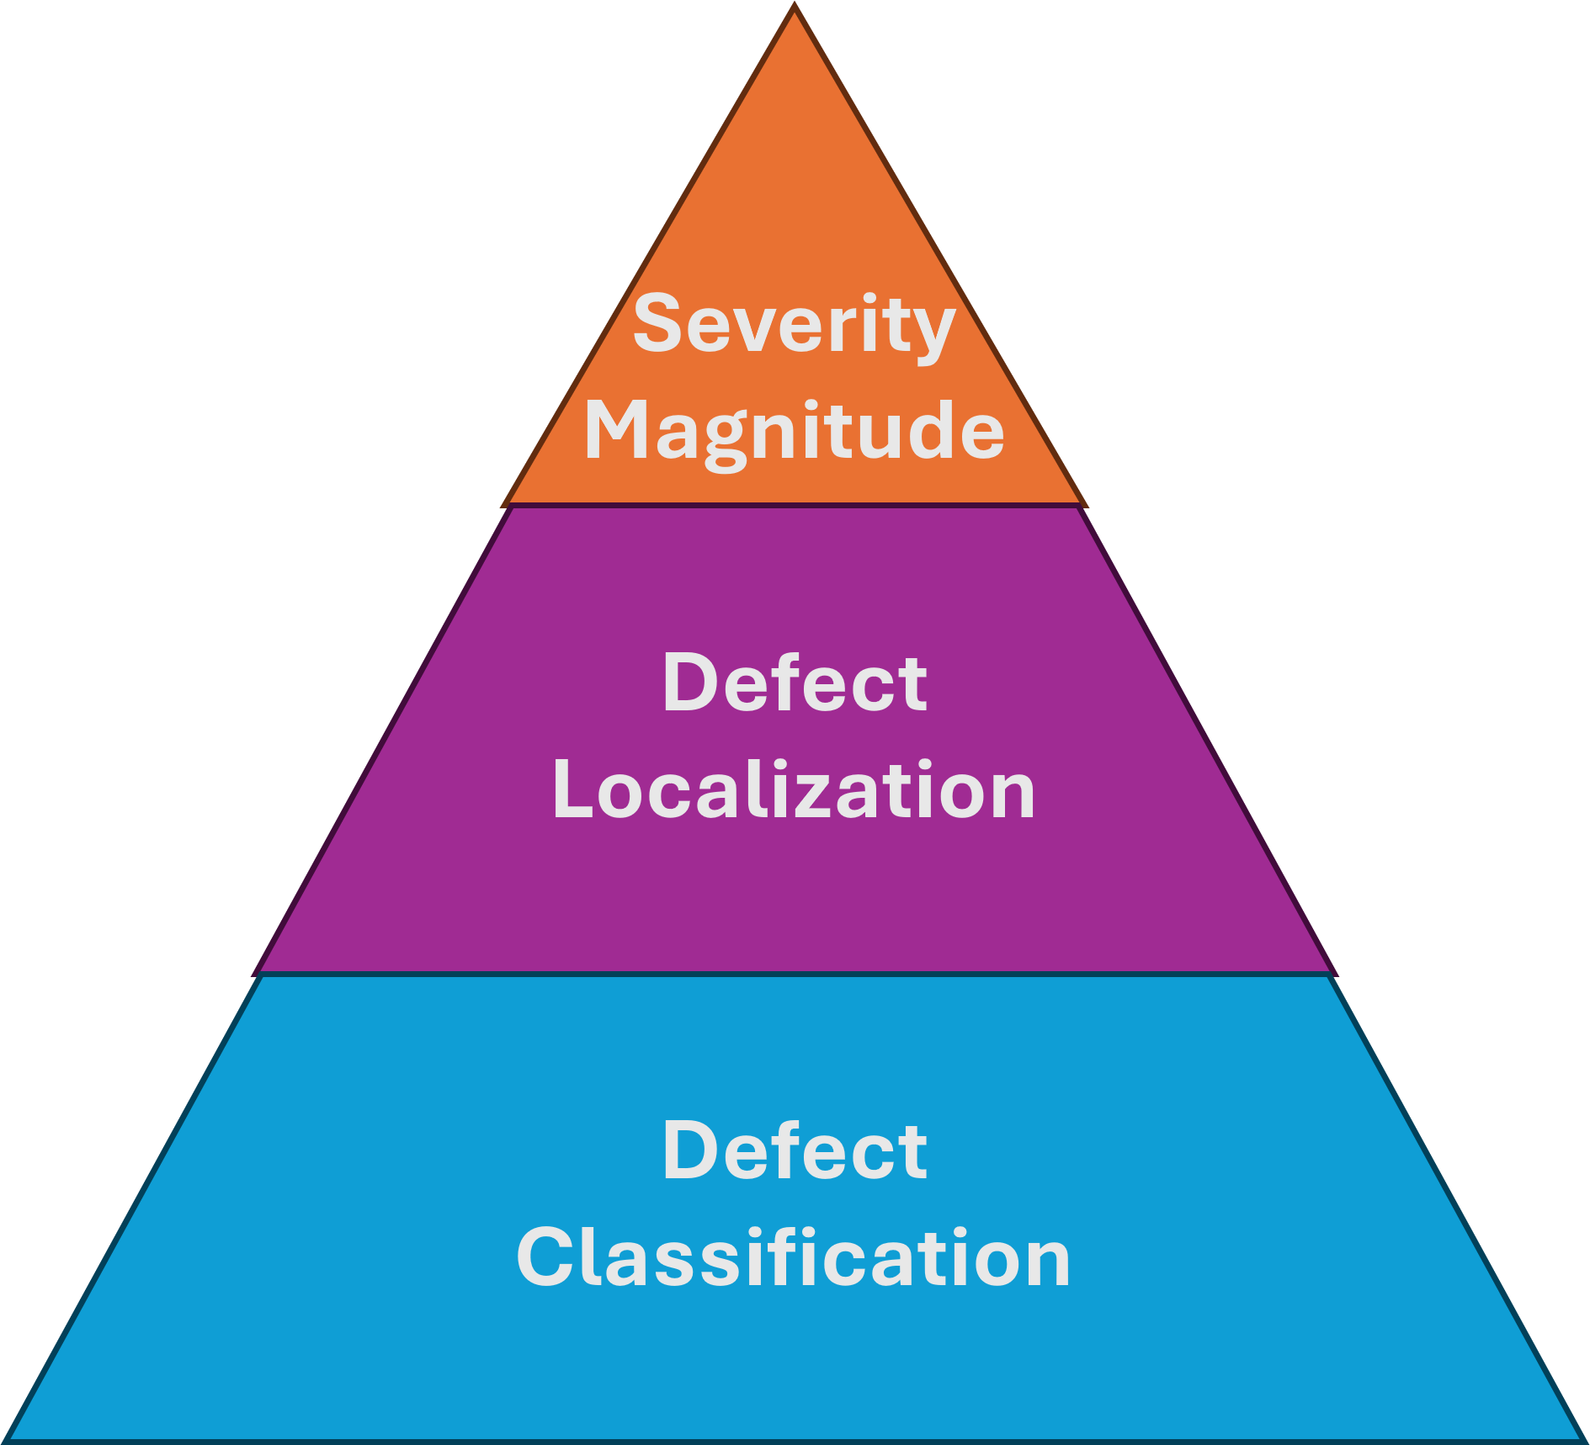
Problem Statement
Ultrasonic C-scan inspection is widely used to detect subsurface defects in composite materials
Manual inspection inconsistent, time-consuming, and difficult for subtle or noisy defects
Supervised ML methods require large labeled datasets—scarce in NDE
Goal: Develop a semi-supervised model that:
Detects presence of defects
Localizes the spatially
Quantifies severity
Approach based on SGAN reconstruction + classification
Notes:
In ultrasonic nondestructive evaluation, technicians rely on C-scan images to identify subsurface defects in composite materials. The challenge is that these scans are noisy, variable, and subtle defects are very easy to miss.
Supervised machine learning approaches require large labeled datasets, which we generally do not have in NDE. So the motivation behind this project is to create a semi-supervised method that can:
1. Detect whether a defect is present,
2. Localize the defect spatially, and
3. Estimate how severe that defect is.
To do this, I implement a Semi-Supervised GAN framework that reconstructs a ‘healthy’ version of the input and uses the reconstruction error to find and score damage

Slide 5
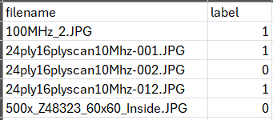
Technical Challenges
Highly variable scan textures and noise patterns
Very small labeled dataset; labels only indicate defect/no-defect (no segmentation)
Need for interpretable defect localization
GAN training instability (balancing generator & discriminator)
Ultrasonic data requires preservation of fine-scale texture
Binary defect/no-defect label csv for training
Notes:
There are several technical challenges associated with this problem.
C-scan images vary significantly in texture and noise, even for healthy samples. We also only have binary labels — defect or no defect — and no pixel-level segmentation.
Another major challenge is training stability in GANs. The generator and discriminator must remain balanced or the model collapses.
Finally, ultrasonic data require models that preserve fine-grained spatial structure, because small delaminations or voids may only affect a few pixels.

Slide 6
Related Work
1. Prajapati et al. (2025) - Semi-supervised GAN for ultrasonic defect classification
Related: Shows SGANs work well for low-labeled NDE data
Different: Their generator doesn’t reconstruct inputs; my SGAN produces heatmaps + severity maps for interpretable defect localization
2. Schlegl et al. (2017) - GAN reconstruction for anomaly detection
Related: Shows SGANs work well for low-labeled NDE data
Different: Their generator doesn’t reconstruct inputs; my SGAN produces heatmaps + severity maps for interpretable defect localization
Notes:
In this project I draw from two main areas of related work.
First, Prajapati et al. implemented a semi-supervised GAN for guided-wave ultrasonic data. Their work is similar because they also use SGANs to overcome label scarcity in NDE. However, their model only performs classification, and their generator takes noise as input. My approach is different — I use a UNet generator that reconstructs the input scan itself, enabling pixel-level defect localization and severity scoring, which their model does not provide.
Second, Schlegl et al. proposed a GAN-based reconstruction method for anomaly detection in medical imaging. This is related because it uses reconstruction error as a signal for abnormalities. My work differs by using a semi-supervised discriminator, adding classification capability, adapting the architecture to ultrasonic signal structure, and incorporating a top-k severity metric

Slide 7
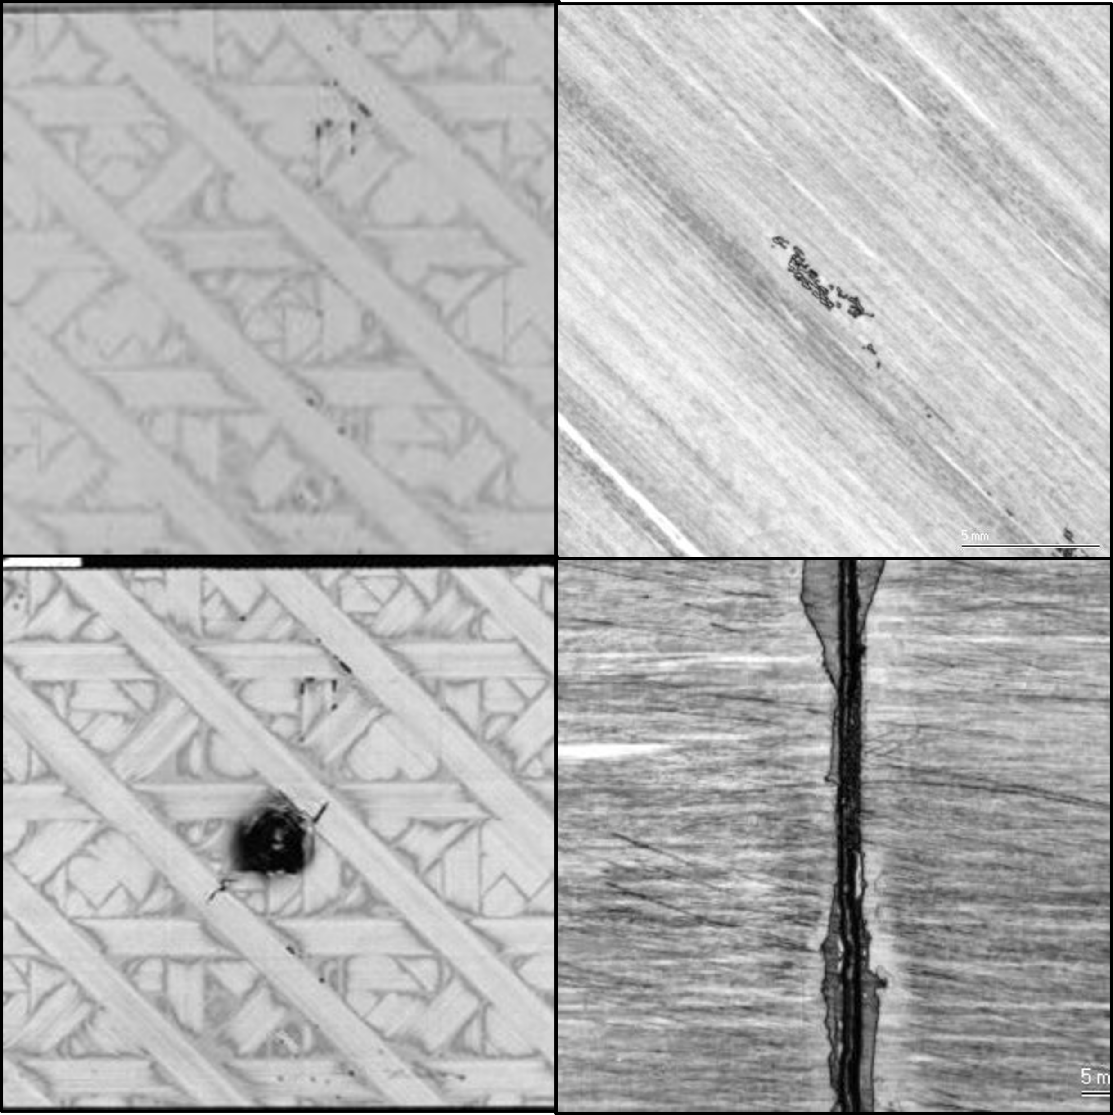
Dataset
Ultrasonic C-scan images of CFRP composite laminates
Each file labeled as 0 = healthy, 1 = defective
Preprocessing (from data.py):
Grayscale → 256×256
Random rotation (±5°), horizontal flip
Normalize to [-1, 1]
Tensor conversion
C-scan examples illustrating structural variations and typical defect modes present in the dataset
Notes:
The dataset consists of ultrasonic C-scan images of composite laminates. Each scan comes with a label of either 0 for healthy or 1 for defective.
Before training, each image is converted to grayscale, resized to 256×256, randomly rotated or flipped for augmentation, converted to a tensor, and normalized to a range of −1 to 1.
These augmentations help the model generalize to new scans with slightly different orientations or noise characteristics

Slide 8
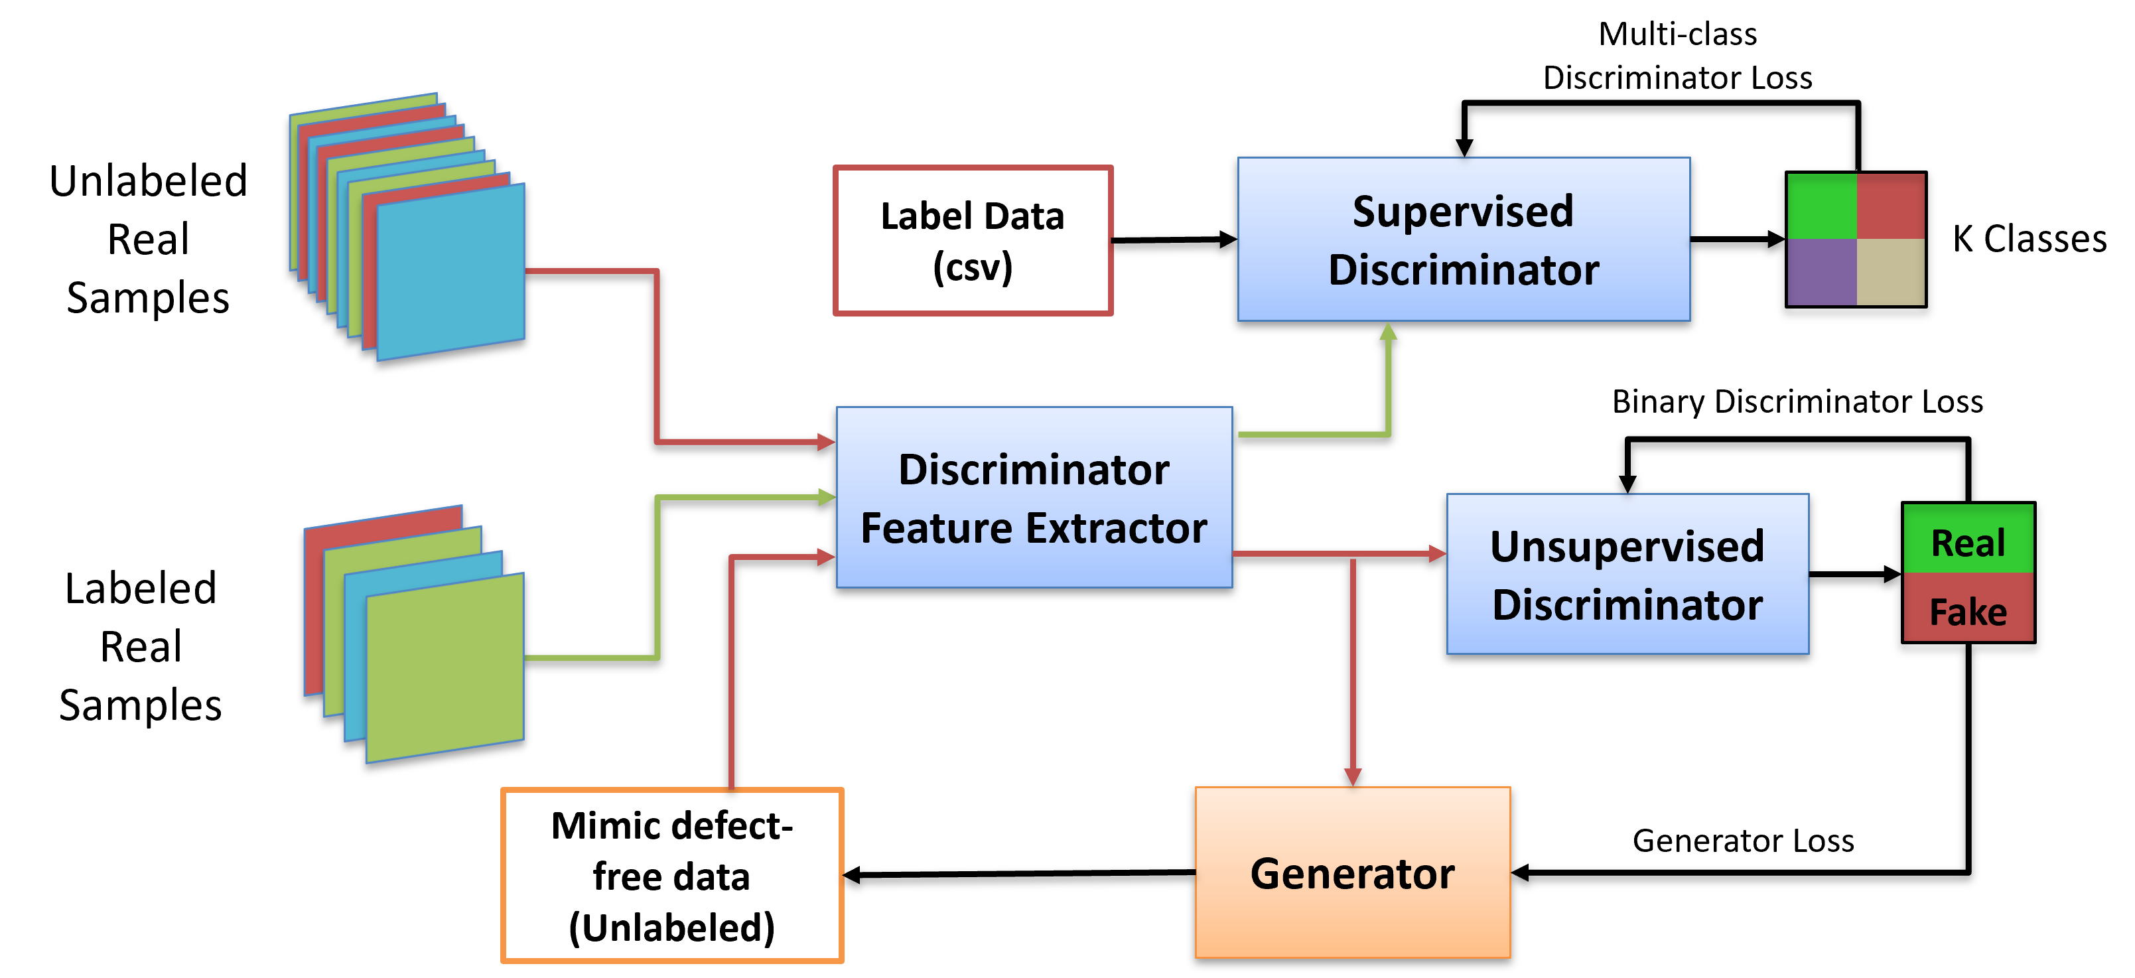
SGAN Architecture Overview
Generator (UNet-based)
Learns to reconstruct defect-free version of input
Skip connections preserve spatial detail
Produces output used to compute spatial residual heatmaps
Discriminator
Dual-headed:
Real/Fake discrimination
Defect/No-defect classification
Enables semi-supervised learning
Notes:
This is the architecture used in my SGAN.
The generator is a UNet. It takes a real scan as input and attempts to reconstruct what a defect-free version of that scan should look like. The skip connections help preserve spatial detail, which is critical for ultrasound-based defect detection.
The discriminator has two output heads:
* One head performs real versus fake discrimination,
* And the other head performs supervised defect classification.
This dual-head structure allows the model to benefit from both labeled and unlabeled data

Slide 9
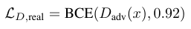
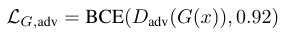
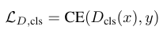
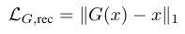
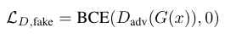
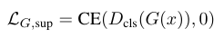
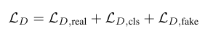
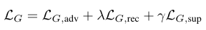
Training Loss Functions
Discriminator Loss
Real/Fake BCE
Supervised CE for defect classification
Fake recognition for reconstructions
Generator Loss
Adversarial loss (fool D)
L1 reconstruction loss (λ = 20)
Classification-forced healthy label
Notes:
The discriminator’s loss includes three components:
1. A real/fake loss using label smoothing,
2. A supervised cross-entropy loss for defect classification,
3. And a fake loss that pushes reconstructions to be detected as fake.
The generator has three main loss terms as well:
1. An adversarial loss that encourages realistic reconstructions,
2. A weighted L1 reconstruction loss that forces the generator to reproduce healthy structure,
3. And a supervised loss that encourages its outputs to appear as non-defective.
This multi-objective setup stabilizes the adversarial training and ensures reconstruction quality

Slide 10
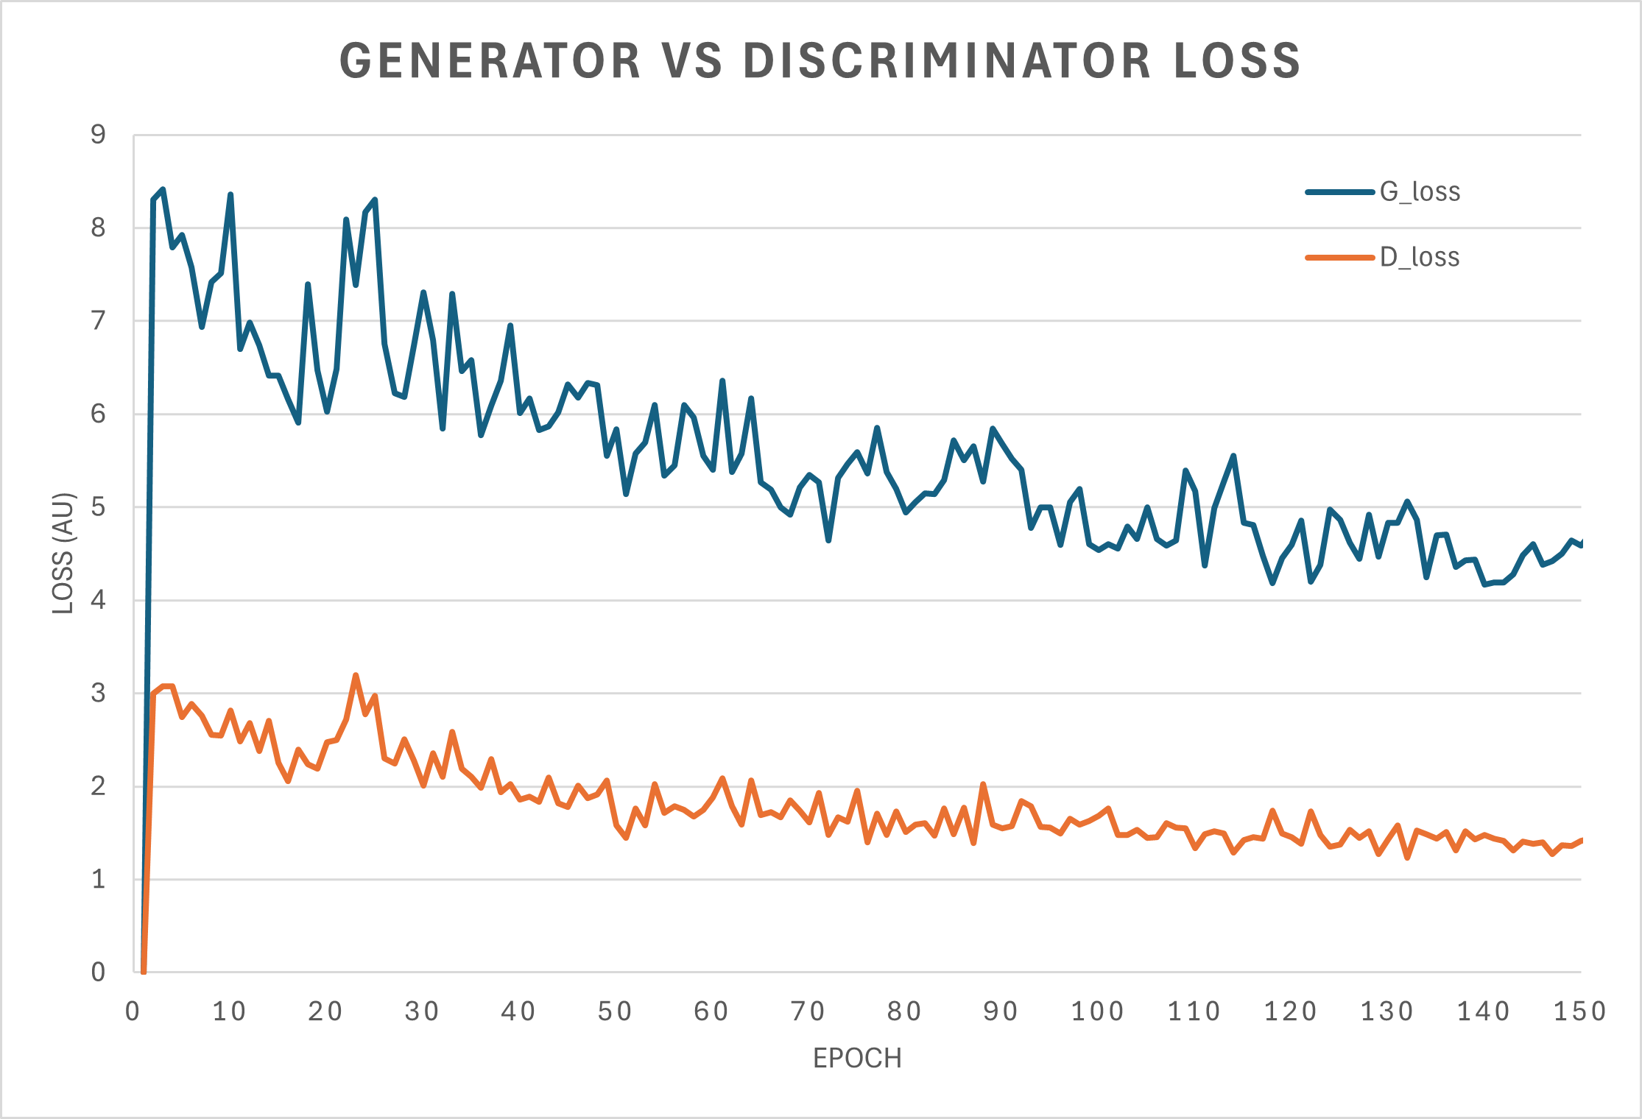
Training Pipeline
Implemented in trainer.py
Alternating G/D updates
Extra G steps when D becomes too strong
Severity metric from top-k reconstruction error
Optimization
Adam optimizers (β₁=0.5, β₂=0.999)
Adaptive update frequency
Label smoothing (0.92 real)
Notes:
The training loop alternates between updating the discriminator and the generator. If the discriminator becomes too strong — meaning its supervised accuracy exceeds 75% — the generator performs an extra update step. This keeps the adversarial game balanced.
We optimize both networks with Adam, using standard GAN hyperparameters.
The pipeline also includes a severity estimation step, where we compute the top-k reconstruction residual values to quantify how significant a defect is

Slide 11
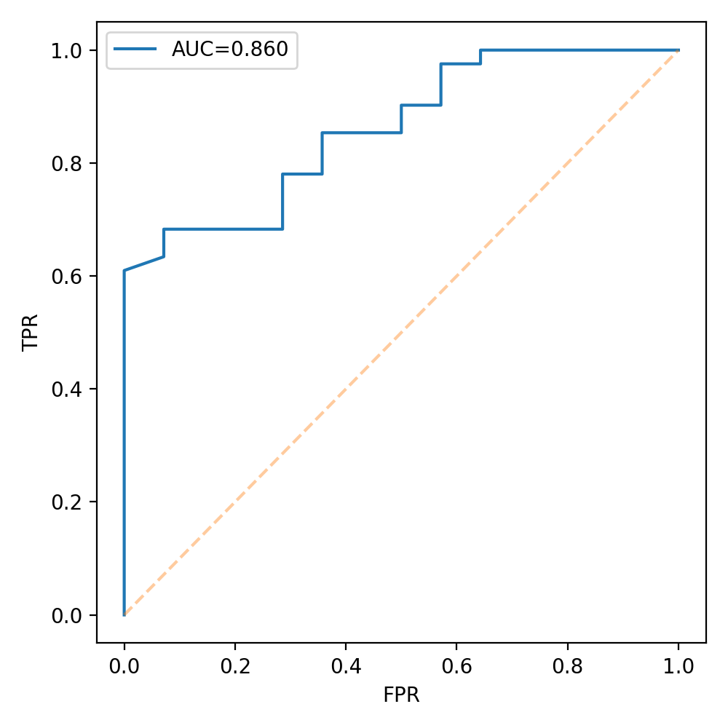
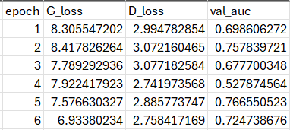
K-Fold Cross Validation
Output per-epoch metric csv example
Implemented in train_cv.py
Stratified splits
Per-epoch metrics: G loss, D loss, AUC
Saves checkpoints each epoch
Combined summary CSV
Useful for small NDE datasets with label imbalance
ROC curve for Fold 1 with corresponding AUC
Notes:
To ensure reliable model evaluation, I implemented a full k-fold cross-validation pipeline.
Each fold trains a new SGAN from scratch and logs:
* Generator and discriminator losses,
* Validation AUC,
* ROC curves,
* Confusion matrices,
* And model checkpoints
This is especially important for ultrasonic NDE datasets, which are typically small and sometimes imbalanced. K-fold evaluation provides a more robust estimate of generalization performance.

Slide 12
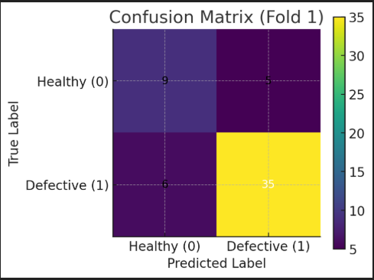
Results: Classification
Discriminator achieves strong separation between defective/non-defective samples
Consistent ROC-AUC across folds
Low cross-fold variance indicates stable generalization
Notes:
Across the folds, the discriminator shows strong separation between defective and non-defective scans. The ROC curves demonstrate consistently high AUC values, indicating reliable classification.
Low variance across folds suggests that the model generalizes well despite limited labeled data
The confusion matrix shows that the model correctly identifies most defective samples, with only six false negatives. Most misclassifications occur on healthy scans, which is expected since the SGAN is more conservative and tends to flag ambiguous cases as defects

Slide 13
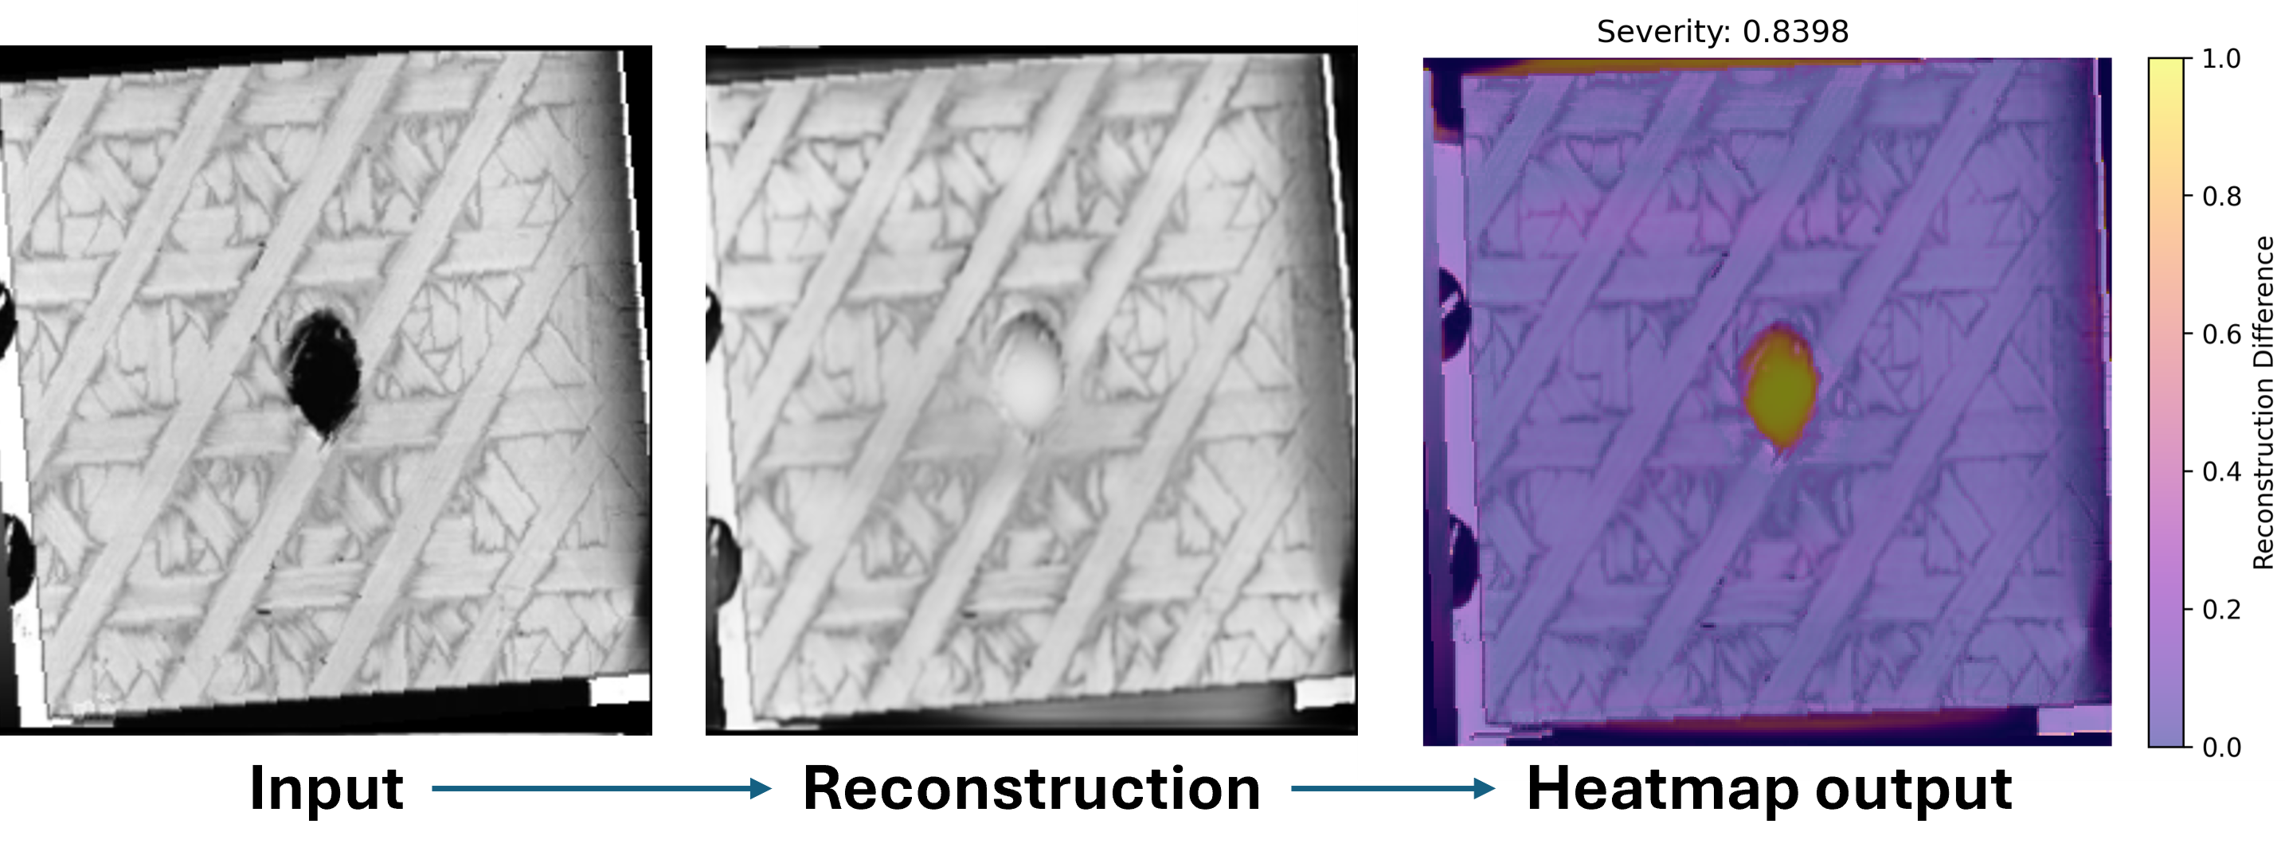
Results: Reconstruction & Localization
Generator reconstructs smooth “healthy” structure
Residual = |input − reconstruction| highlights local defects
Produces intuitive heatmaps
Severity score computed using top-k residual intensity
Notes:
Here we see an example of the SGAN’s reconstruction behavior.
The generator reconstructs a clean version of the scan, and by subtracting this from the original, we obtain a residual heatmap. This heatmap highlights localized regions of structural difference, which correspond to potential defects.
This gives the model interpretability — not only does it detect defects, but it shows where they are

Slide 14
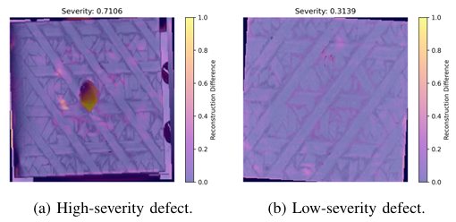
Results: Severity Estimation
Top-k residual error correlates with physical defect magnitude
High-severity vs low-severity defects clearly separated
Notes:
This slide shows how the top-k reconstruction residual metric distinguishes between high- and low-severity defects.
More severe defects produce higher-intensity reconstruction errors, while mild defects generate weaker signals.
This severity score is useful when prioritizing inspection results or automating triage in large datasets

Slide 15
Broader Impact
Benefits:
Automated, interpretable NDE
Less reliance on large labeled datasets
Provides classification + localization + severity estimation
Extensible to other modalities (B-scan, A-scan)
Limitations:
GAN training instability
Severity metric empirical (not physically constrained)
Reconstruction may blur subtle fine-scale defects
Notes:
The broader impact of this work extends across several areas.
First, it enables automated and interpretable NDE, reducing reliance on large annotated datasets. Second, it provides multiple levels of output — classification, localization, and severity — which can be integrated into inspection workflows. Finally, this framework can be adapted to other ultrasonic modalities such as A-scans and B-scans.
However, there are limitations. GANs can be unstable, the severity metric is empirical rather than physics-grounded, and subtle defects may be smoothed out during reconstruction

Slide 16
Future Work
Add physics-informed loss terms incorporating ultrasonic wave propagation
PDE-constrained generator penalty
Expand to multi-modal ultrasonic data
A-scans, B-scans, multi-frequency inputs
Experiment with newer architectures
Diffusion-based reconstruction models
Vision transformers for discriminator
Improve severity metric calibration using physical simulation
Notes:
There are several exciting directions for future extension.
One is adding physics-informed loss terms that incorporate wave propagation constraints. This could help the generator produce physically realistic reconstructions.
Another is expanding the dataset to include different ultrasonic scan types, such as B-scans or multi-frequency data.
Finally, we could explore more advanced architectures such as diffusion models or transformer-based discriminators, and develop more physically calibrated severity scoring methods

Slide 17
References
[1] K. K. Prajapati, A. Ghosh, and M. Mitra, “Semi-supervised generative Adversarial Network (SGAN) for damage detection in a composite plate using guided wave responses,” Mechanical Systems and Signal Process ing, vol. 232, p. 112686, Jun. 2025. doi:10.1016/j.ymssp.2025.112686
[2] K. K. Prajapati, “Lamb Wave-Based Structural Health Monitoring using Deep Learning Techniques,” thesis, 2025
[3] J. Hooks, ”CSCE768 Final-Project,” GitHub, Dec. 2025. [Online]. Available: https://github.com/jhooks5313/CSCE768 Final-Project.git
[4] T. Salimans, I. Goodfellow, W. Zaremba, V. Cheung, A. Radford, and X. Chen, “Improved techniques for training GANs,” in Proc. NeurIPS, 2016.
[5] T. Schlegl, P. Seeb¨ock, S. M. Waldstein, U. Schmidt-Erfurth, and G. Langs, “Unsupervised anomaly detection with generative adversarial networks to guide marker discovery,” in Proc. IPMI, 2017.
[6] M. Raissi, P. Perdikaris, and G. E. Karniadakis, “Physics-informed neural networks: A deep learning framework for solving forward and inverse problems involving nonlinear partial differential equations,” Journal of Computational Physics, 2019.
[7] G. E. Karniadakis, I. G. Kevrekidis, L. Lu, P. Perdikaris, S. Wang, and L. Yang, “Physics-informed machine learning,” Nature Reviews Physics, 2021.
[8] J. Hu, “Lecture 9: Generative Models,” CSCE 768 Pattern Classification, Dept. of Computer Science and Engineering, Univ. of South Carolina, 2025, [PowerPoint slides].
Notes:
I’d like to thank Dr. Hu for teaching the core concepts that enabled this project, and Dr. Banerjee for his mentorship and deep insight into ultrasonic NDE. Their guidance was invaluable

